Slide 1

Cyber Defense Organization
Fall 2018 - Intro to Networking

Slide 2
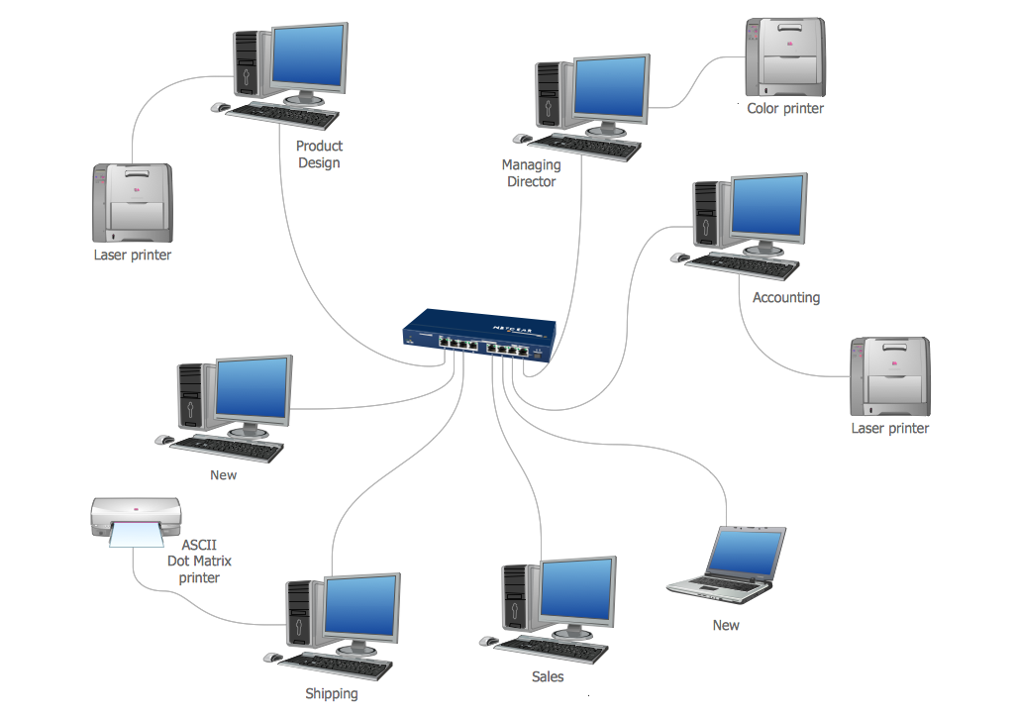
What is networking?
“A computer network is a group of computer systems and other computing hardware devices that are linked together through communication channels to facilitate communication and resource-sharing among a wide range of users. Networks are commonly categorized based on their characteristics.” - Technopedia

Slide 3

How do our devices communicate?
Using Binary!
Electronic signals that are meant to translate to “1” and “0”
What do these signals mean?

Slide 4

Network Protocols
Standardized protocols that are used to move data (payloads) around a network
Allow Communication on the internet
Important ones:
TCP/IP
UDP
ARP
ICMP

Slide 5
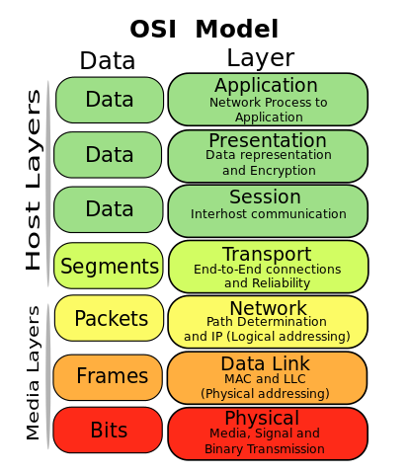
TCP/IP Stack (OSI Model)
Used by every protocol and device for transmitting data
Encapsulation
Important Info
Port Numbers
Session Numbers
IP Address
MAC Address

Slide 6

Important Addresses
MAC Address (00-17-ab-be-28-1c)
Unique address to that device
Given to it when created
IP Address (192.168.1.3)
Internet Address
Home address on mail
Subnet mask (255.255.255.0)
Networks address

Slide 7
Let's mess with packet tracer!!
Notes:
Give Overview of Packet Tracer at this point
Explain its function
Explain how to use it

Slide 8

Create a Simple Network
Drag 2 Generic Computers and 1 generic Switch to the Workspace
Connect the computers to the switch using copper cables
Give these to IP’s to the computer's (Subnet mask: 255.255.255.0)
192.168.1.2
192.168.1.4
Notes:
Have them ping the other computer in the network with simulation mode in order to have them see the packets move

Slide 9

Why are we choosing Address with 192.168?
Private Address Space
Freely Use
Three Spaces available
10.0.0.0 - 10.255.255.255
172.16.0.0 - 172.31.255.255
192.168.0.0 - 192.168.255.255
Public IPs

Slide 10
Let’s see a more complex Network
Notes:
Use the Sample network found on the desktop: Extract ISP.1a(2)
Explanation of what is being shown here
Try Pinging other networks IP to show the movement of the packet
Open the website east.com in simulation to show people the movement of the HTTP packets

Slide 11

More Complex Networking
Subnetting & Variable Subnetting
VLANS
Access Control Lists

Slide 12



Cya Next week!
Gap week!
Send your cute pet picture to Liam!
wcsmith@albany.edu
Follow us on Twitter? Add on myInvolvement?
CCDC Team! - Monday 7:15pm BB121
Windows Security!
- Friday 3pm BB123

